Slide 1
Overview of Modeling Method

Slide 2
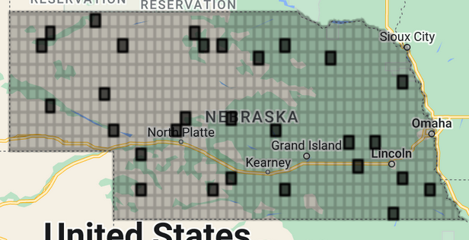
Random selection within grid

Slide 3
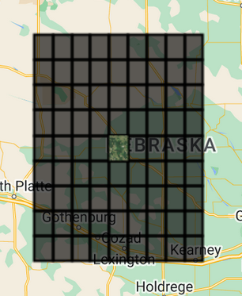
Gather around the nearest 72 grids

Slide 4
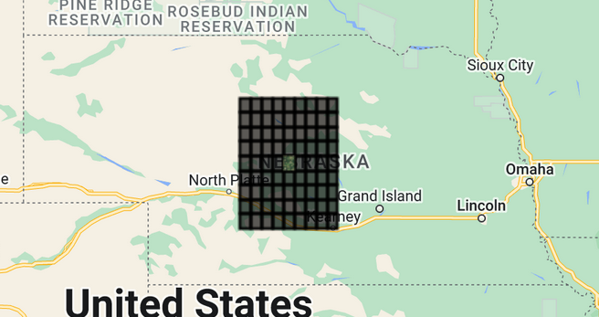
Apply model to the nearest 72 grids ~10,000 sq miles or 12% of the state

Slide 5
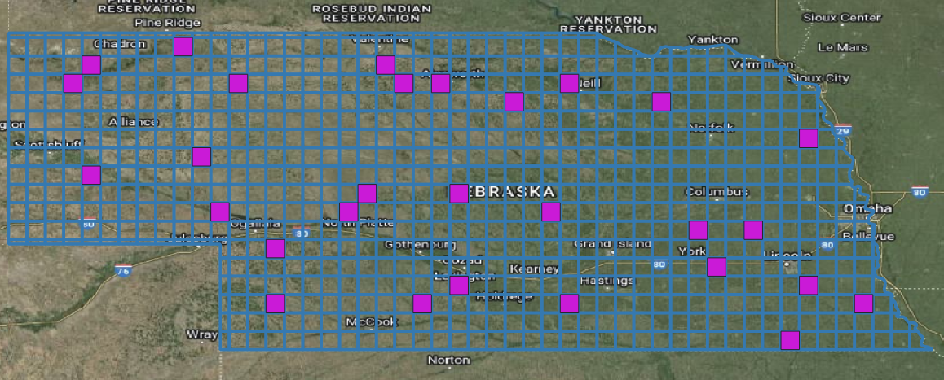
Random selection within grid

Slide 6
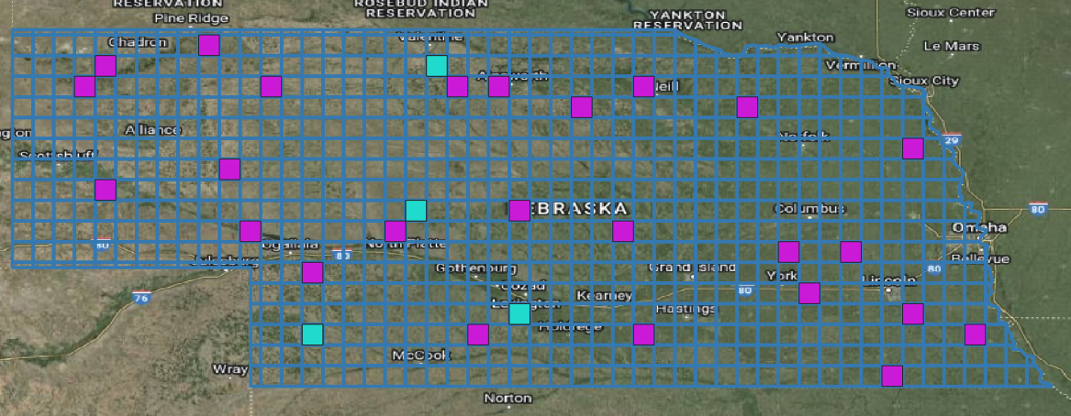
Best preforming models 2020

Slide 7
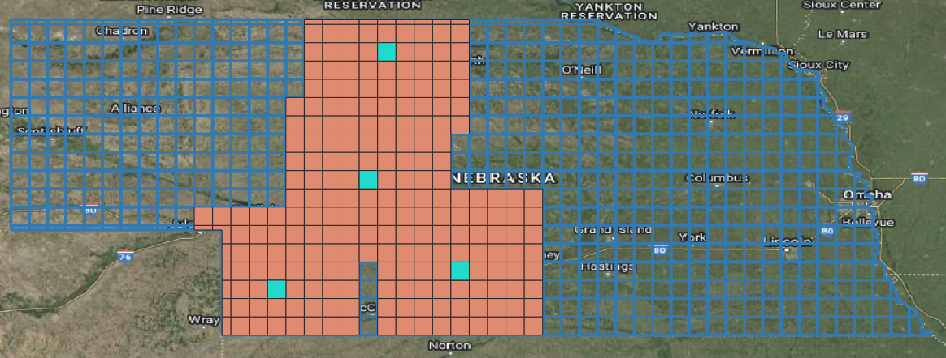
Best preforming models (5)

Slide 8
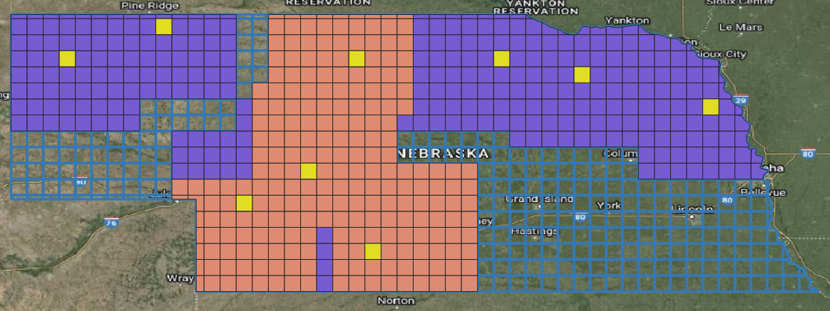
Next best models (4)

Slide 9
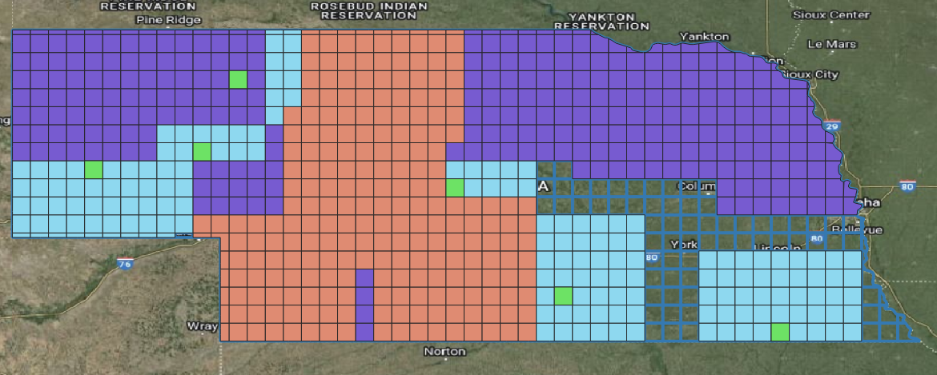
Next best models (3)

Slide 10
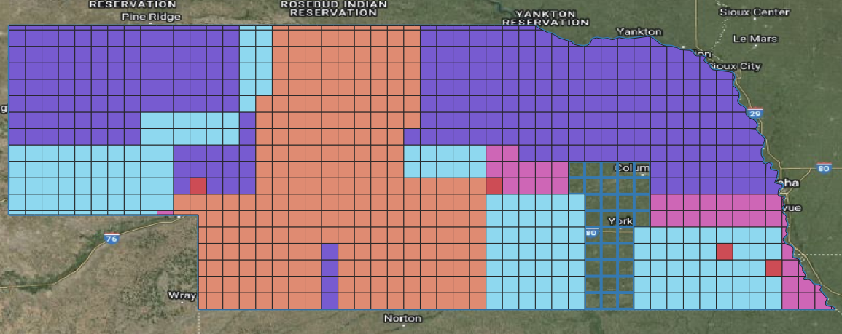
Next best models (2)

Slide 11
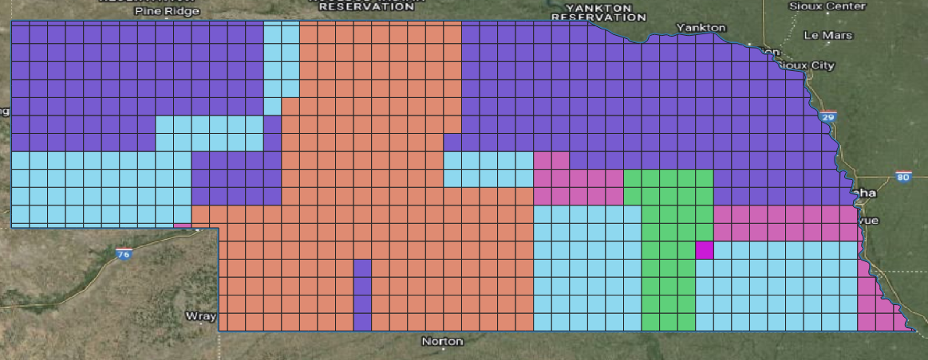
Next best models (1)

Slide 12

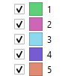
Result

Slide 13
Validation Effort –
Two metrics
Overall classification accuracy.
Independent of the masks/end use of the models, how well did they capture forest
Error Propagation measure
With masks applied how well do the models capture trees outside of forest.

Slide 14
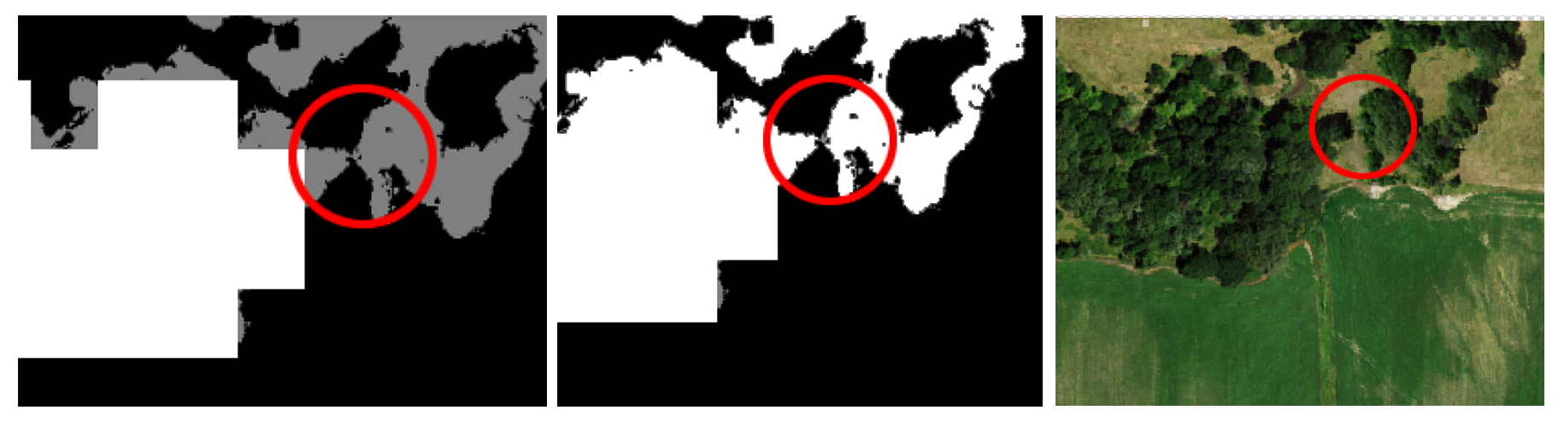
Validation Effort – traditional mask
Creates some edge effects that are true to the data

Slide 15
Validation Effort – Expanded mask
Better reflects what you might see on the ground.

Slide 16
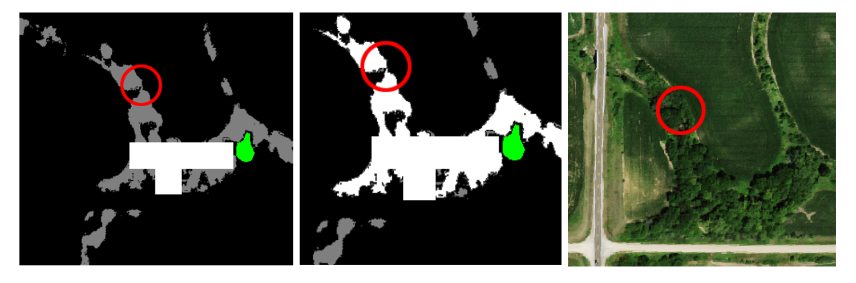
Traditional – 2.4% error
Connective – 13.3% error

Slide 17
True Positive
Predicted forest – Is forest
False Negative
Predicted not forest – Is forest
General Statement about the classification
Commonly over predicts tree cover
Uncommon to under predict tree cover
Good at differentiating tree from not tree
High true positive rate
Very high true negative rate
Low false negative rate
Moderate false positive rate
Because most of the area is not trees, the overall classification accuracy will be close to 100%
False Positive
Predicted forest – Is not forest
True Negative
Predicted not forest – Is not forest

Slide 18
True Positive
Predicted forest – Is forest
False Negative
Predicted not forest – Is forest
recall
TP / (TP + FN)
Out of all the actual forest, how much was correctly identified
False Positive
Predicted forest – Is not forest
True Negative
Predicted not forest – Is not forest
Our reported Error
False Negative + False Positive /
Total Classified Area
precision
TP / (TP + FP)
Out of all the predicted forest area how much was actually forest

Slide 19
What is the best measures for the error propegation

Slide 20
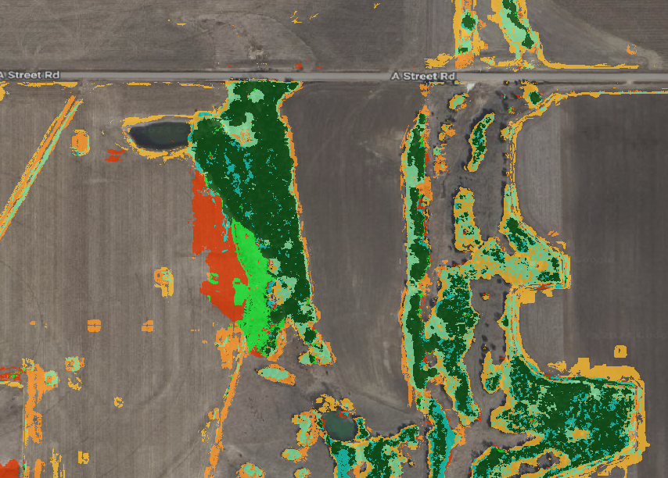
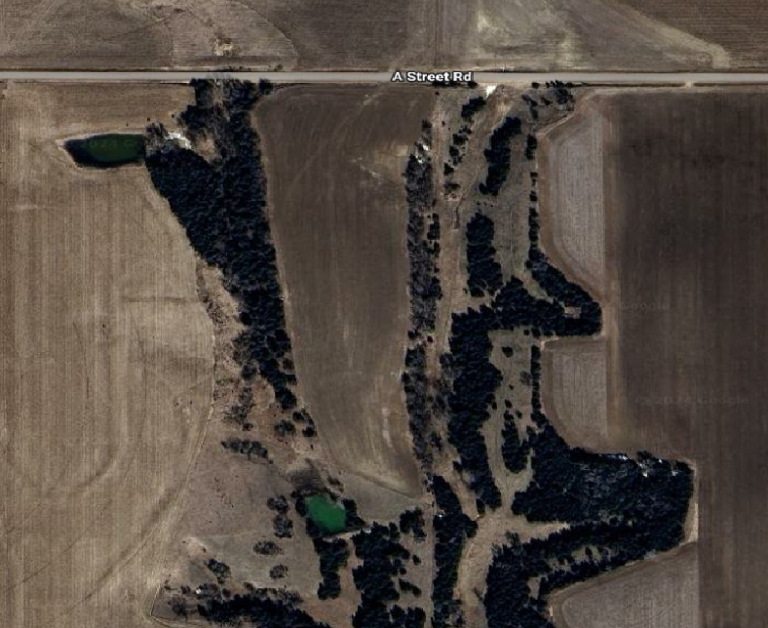
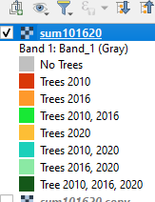
Change over time

